Slide 1
Hadoop & Map Reduce

Slide 2
Contents
What are: Big Data and Hadoop?
Advantages of Hadoop
Hadoop Distributed Filesystem (HDFS)
The MapReduce framework
The Hadoop environment and evolution

Slide 3
Big Data

Slide 4
What is big data?

Slide 5
What is big data?
a bunch of HYPE!
… and get off my lawn!

Slide 6
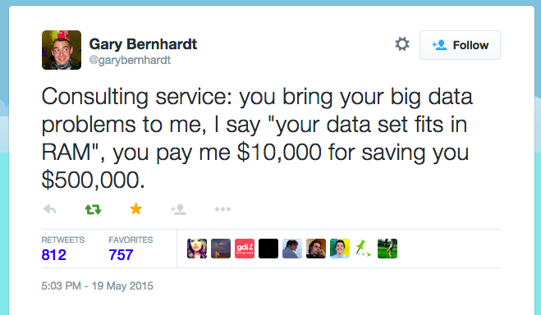
What is big data?
a bunch of HYPE!
… and get off my lawn!
Notes:
http://yourdatafitsinram.com/

Slide 7
What is big data?
Various definitions:
Data that cannot be stored in more traditional relational databases
on the order of high millions to billions of records, high thousands to millions of columns, TB to PB
Notes:
Successful Service
Here is a synopsis of how the typical RDBMS scaling story runs. The following list presumes a successful growing service:
Initial public launch
Move from local workstation to shared, remote hosted MySQL instance with a well-defined schema.
Service becomes more popular; too many reads hitting the database
Add memcached to cache common queries. Reads are now no longer strictly ACID; cached data must expire.
Service continues to grow in popularity; too many writes hitting the database
Scale MySQL vertically by buying a beefed up server with 16 cores, 128 GB of RAM, and banks of 15 k RPM hard drives. Costly.
New features increases query complexity; now we have too many joins
Denormalize your data to reduce joins. (That’s not what they taught me in DBA school!)
Rising popularity swamps the server; things are too slow
Stop doing any server-side computations.
Some queries are still too slow
Periodically prematerialize the most complex queries, try to stop joining in most cases.
Reads are OK, but writes are getting slower and slower
Drop secondary indexes and triggers (no indexes?).

Slide 8

What is Hadoop?
Hadoop is…
Hadoop Common
HDFS
YARN
MapReduce

Slide 9
HDFS + MapReduce
“Apache Hadoop is a framework for running applications on large clusters of commodity hardware which implements the MapReduce computational paradigm and uses HDFS to store data among its nodes.”

Slide 10
Some history
early ‘00s: Doug Cutting working on open-source web search engine called Nutch
“dang… parallel computing is hard.”
2003/4: Google publishes technical papers on their solution to this problem (MapReduce) and the filesystem that it runs on (Google Filesystem)
2004-6: Apache devs make open source version
2006: Doug Cutting hired to develop this project at Yahoo
2007: Doug Cutting open-sources Apache Hadoop

Slide 11
Hadoop = HDFS + MapReduce
Hadoop Distributed Filesystem (HDFS)
Files sitting on different machines, but they behave like a single file system
This system is optimized for fault tolerance
MapReduce
programming model for parallel processing
The implementation also makes it fault tolerant.

Slide 12
Advantages

Slide 13
Advantages
Distributed read/write capacity

Slide 14
Advantages
Distributed read/write capacity
Non-distributed hard drive processing is slow. 75MB/sec processing speed – read 100TB = 16 days
Often, some data is more popular than other data. So some data are read more frequently. Thus most servers with data sit there unused. These resources can be more efficiently distributed.

Slide 15
Advantages
Distributed read/write capacity
But this distribution comes with a cost

Slide 16
Advantages
Distributed read/write capacity
But this distribution comes with a cost
With multiple machines, server failure and error rates increase dramatically: i.e. at least once/day
Hadoop expects these failures, and deals with them

Slide 17
Advantages
Distributed read/write capacity
Deals with hardware failure
With multiple machines, server failure and error rates increase dramatically: i.e. at least once/day
Hadoop expects these failures, and deals with them
Node recovery: nodes can get their act together and rejoin the party without full restart

Slide 18
Advantages
Distributed read/write capacity
Deals with hardware failure
Improves speed

Slide 19
Advantages
Distributed read/write capacity
Deals with hardware failure
Improves speed
read/write in parallel: 100 TB, 75MB/sec HD
1 machine:
75MB/sec → 16 days
1000 machines:
75,000MB/sec = 75 GB/sec →22 minutes

Slide 20
Advantages
Distributed read/write capacity
Deals with hardware failure
Improves speed
Fault tolerance

Slide 21
Advantages
Distributed read/write capacity
Deals with hardware failure
Improves speed
Fault tolerance
Even if a process fails, it’s a small part and not the entire MapReduce job
Data recovery: one node can pick up workload of another
HDFS stores each data block on 3 machines by default

Slide 22
Advantages
Distributed read/write capacity
Deals with hardware failure
Improves speed
Fault tolerance
Cheaper

Slide 23
Advantages
Distributed read/write capacity
Deals with hardware failure
Improves speed
Fault tolerance
Cheaper
computer A has power X
computer B has power 4*X
cost(B) >> 4*cost(A)

Slide 24
Hadoop
Hadoop is a framework

Slide 25
Hadoop
Hadoop is a framework
for distributed processing

Slide 26
Hadoop
Hadoop is a framework
for distributed processing
of large data sets

Slide 27
Hadoop
Hadoop is a framework
for distributed processing
of large data sets
across a cluster of many computers

Slide 28
Hadoop
Hadoop is a framework
for distributed processing
of large data sets
across a cluster of many computers
that implements map and reduce functions

Slide 29
Hadoop
Hadoop is a framework
for distributed processing
of large data sets
across a cluster of many computers
that implements map and reduce functions
using a distributed filesystem (HDFS)

Slide 30
Hadoop Distributed Filesystem (HDFS)

Slide 31
Hadoop Distributed Filesystem (HDFS)
breaks data into blocks, replicates and stores these blocks across different nodes in a cluster

Slide 32
Hadoop Distributed Filesystem (HDFS)
breaks data into blocks, replicates and stores these blocks across different nodes in a cluster
master-slave architecture

Slide 33
Hadoop Distributed Filesystem (HDFS)
name node (master): maintains name system, manages data blocks

Slide 34
Hadoop Distributed Filesystem (HDFS)
name node (master): maintains name system, manages data blocks
data nodes (slave): deployed storage machines. MapReduce analyses happen here.

Slide 35
Hadoop Distributed Filesystem (HDFS)
name node (master): maintains name system, manages data blocks
data nodes (slave): deployed storage machines. MapReduce analyses happen here.
secondary name node: performs periodic checkpoints (restart the name node from checkpoint in case of name node failure)

Slide 36
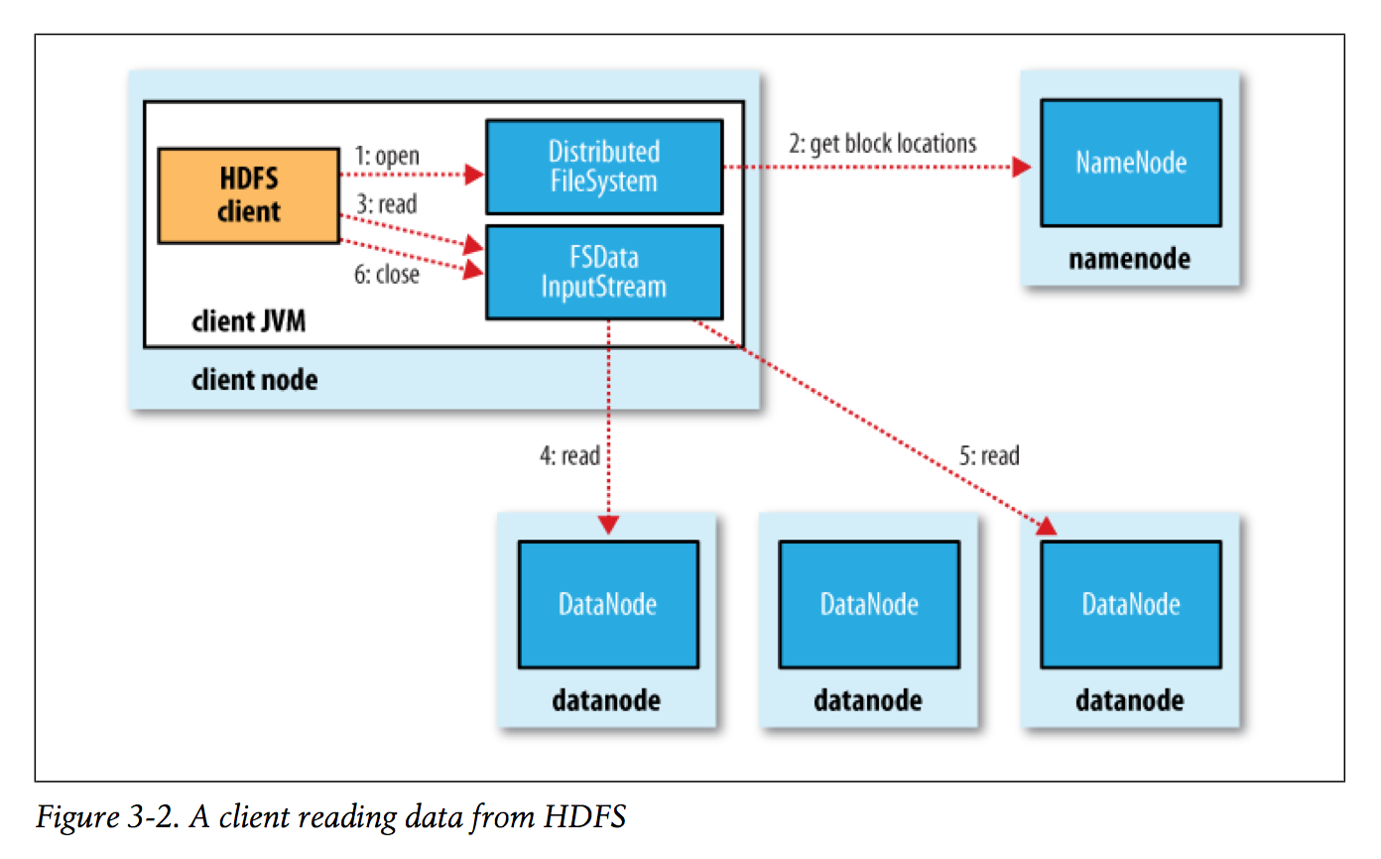
Hadoop Distributed Filesystem (HDFS)

Slide 37
MapReduce

Slide 38
MapReduce
MapReduce = Map + Reduce functions

Slide 39
MapReduce
MapReduce = Map + Reduce functions
MAP function
Input: raw data
Output: (key, value) pairs
REDUCE function
Input: all (key, value) pairs with a certain key
Output: summarized result for that key

Slide 40
MapReduce
Compute word counts for a very large book.
MAP function
Input: raw text data
Output: For every word (“the”), return (“the”, 1) key-value pair
REDUCE function
Input: list of all (“the”, 1) pairs
Output: count of all “the”s in the book (“the”, 2343)

Slide 41
MapReduce
Mean precipitation over time, across cities
MAP function
Input: large table of precipitation over time, location data
Output: key, value pairs are like: (San Francisco, 2 cm)
REDUCE function
Input: list of all (city, precipitation) pairs for a given city
Output: average precipitation for that city
(San Francisco, 0.51 cm)

Slide 42
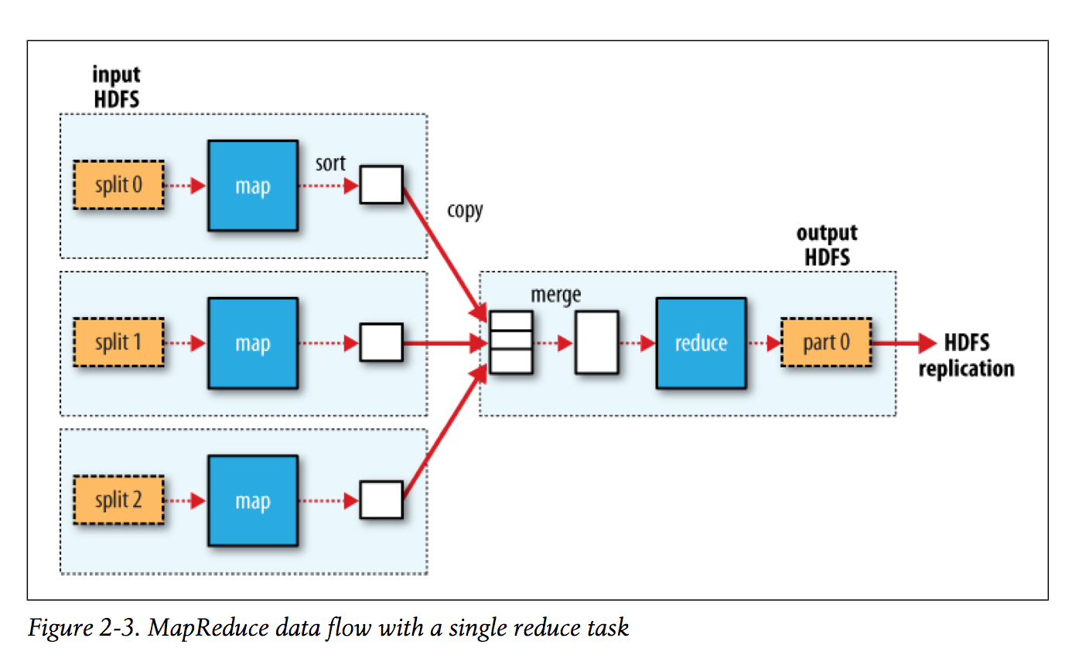
MapReduce

Slide 43
MapReduce
Master-slave architecture
Master: jobtracker
coordinator, scheduler
reassigns failed jobs
Slave: tasktracker
run tasks, send reports to jobtracker
lack of report → failure

Slide 44
MapReduce
Data locality
“Push the computation to the data”
Mapper code is sent to all data nodes and run locally
Thus no data is moved over the network → faster.

Slide 45
MapReduce

Slide 46
is that all there is to map reduce?
no!
map function: turns data into (key, value) pairs
reduce function: reduce all values for key to one value or set

Slide 47
is that all there is to map reduce?
no!
input reader: gets data from file system
map function: turns data into (key, value) pairs
reduce function: reduce all values for key to one value or set

Slide 48
is that all there is to map reduce?
no!
input reader: gets data from file system
map function: turns data into (key, value) pairs
reduce function: reduce all values for key to one value or set
output writer: write output to file system

Slide 49
is that all there is to map reduce?
no!
input reader: gets data from file system
map function: turns data into (key,value) pairs
partition function: assign keys to reducer servers
reduce function: reduce all values for key to one value or set
output writer: write output to file system

Slide 50
is that all there is to map reduce?
no!
input reader: gets data from file system
map function: turns data into (key,value) pairs
compare function: sort keys, collecting pairs with the same keys
partition function: assign keys to reducer servers
reduce function: reduce all values for key to one value or set
output writer: write output to file system

Slide 51
is that all there is to map reduce?
no!
input reader: gets data from file system
map function: turns data into (key, value) pairs
compare function: sort keys, collecting pairs with the same keys
combiner function: reduce network traffic
partition function: assign keys to reducer servers
reduce function: reduce all values for key to one value or set
output writer: write output to file system

Slide 52
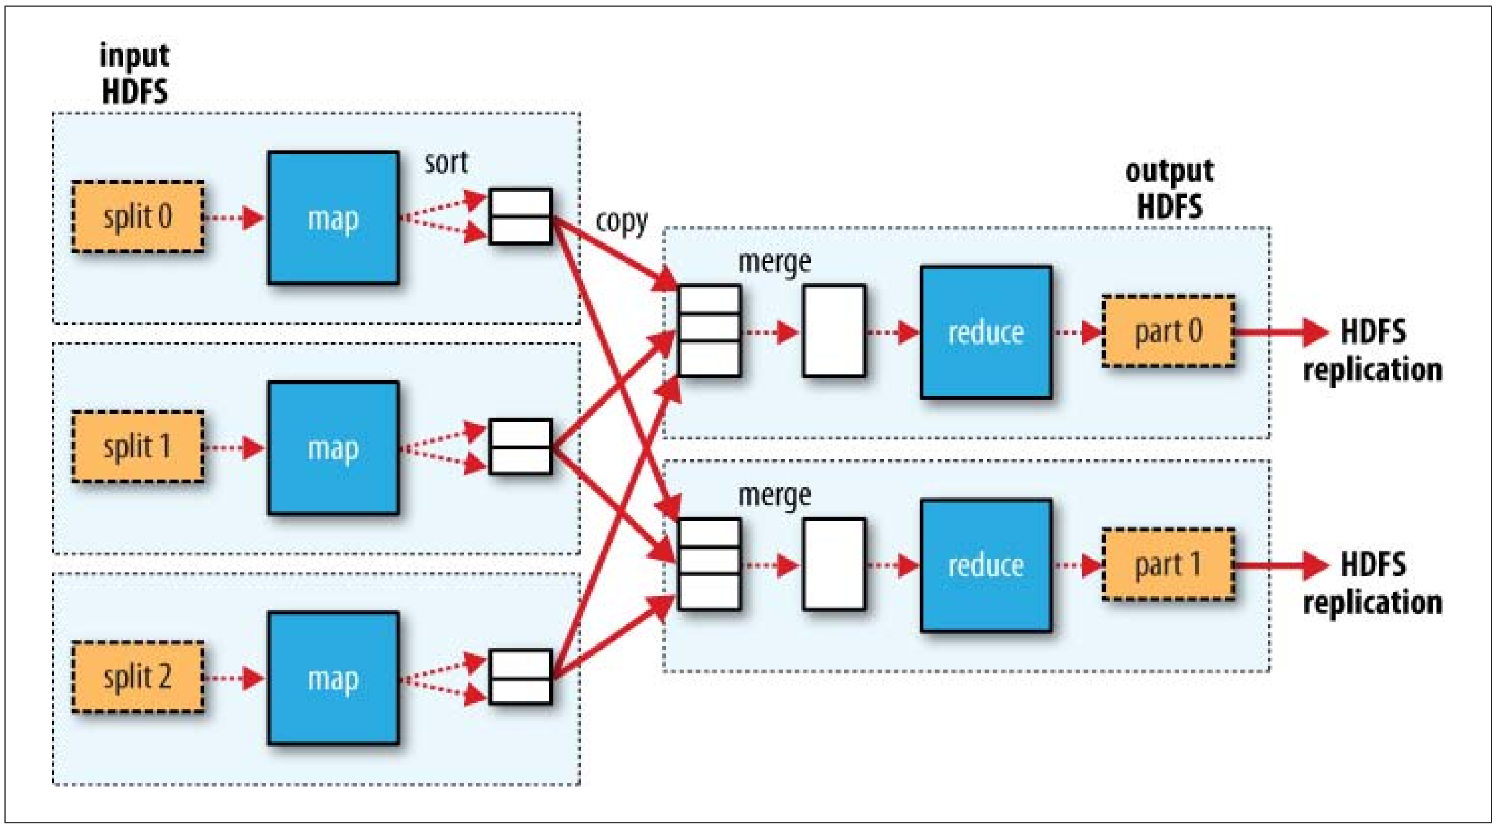
MapReduce

Slide 53
Hadoop environment
core:
Hadoop Common
HDFS
YARN
MapReduce

Slide 54
Hadoop environment
core: Common, HDFS, YARN, MapReduce
Hive: takes over management of HDFS storage, interprets & runs jobs via SQL queries
Pig: write tasks more easily (for MapReduce+HDFS)
HBase: take HDFS and add some good stuff from relational databases (make hadoop more SQL-like)
Sqoop: import SQL →HDFS
Avro: serialization
Zookeeper: coordinator

Slide 55
Hadoop environment
Mahout – machine learning for Hadoop (err… Spark)
Flume – stream logs into Hadoop
Whirr – cloud platform libraries
HCatalog – treat disparate data storage as one thing
MRUnit – unit testing for Hadoop
BigTop – attempt to re-define “core Hadoop”
Oozie – workflow to integrate Hadoop + other tasks

Slide 56
Apache Spark
Popularized in ~ 2013-2014
load all the data into memory
up to ~100 times faster than MapReduce
iterative algorithms become reasonable!
Popular configuration:
HDFS / S3
YARN / Mesos
MapReduce Spark

Slide 57
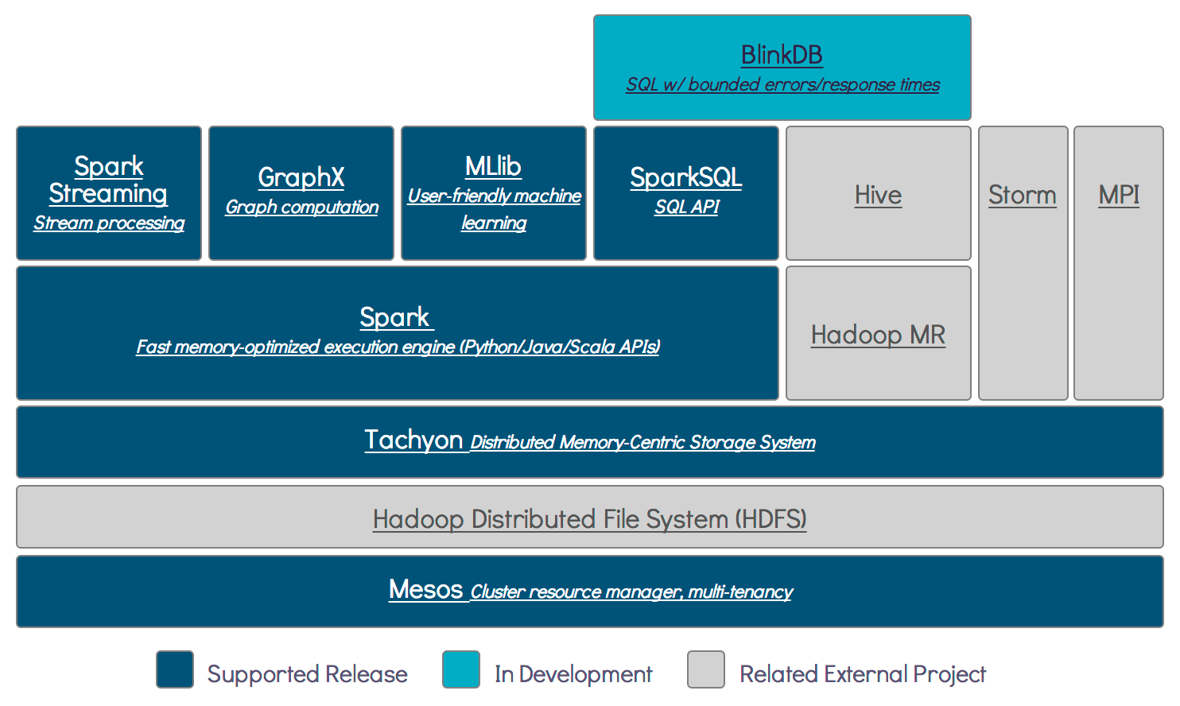
Notes:
Berkeley AMPLab diagram

Slide 58
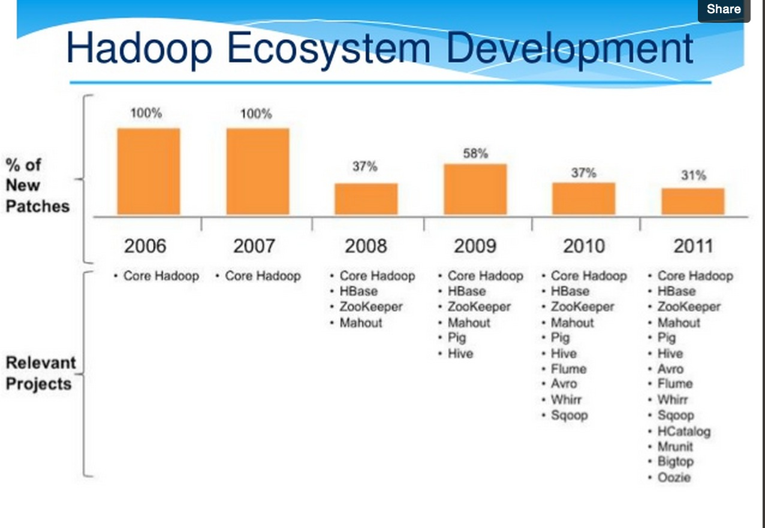
Hadoop evolution

Slide 59
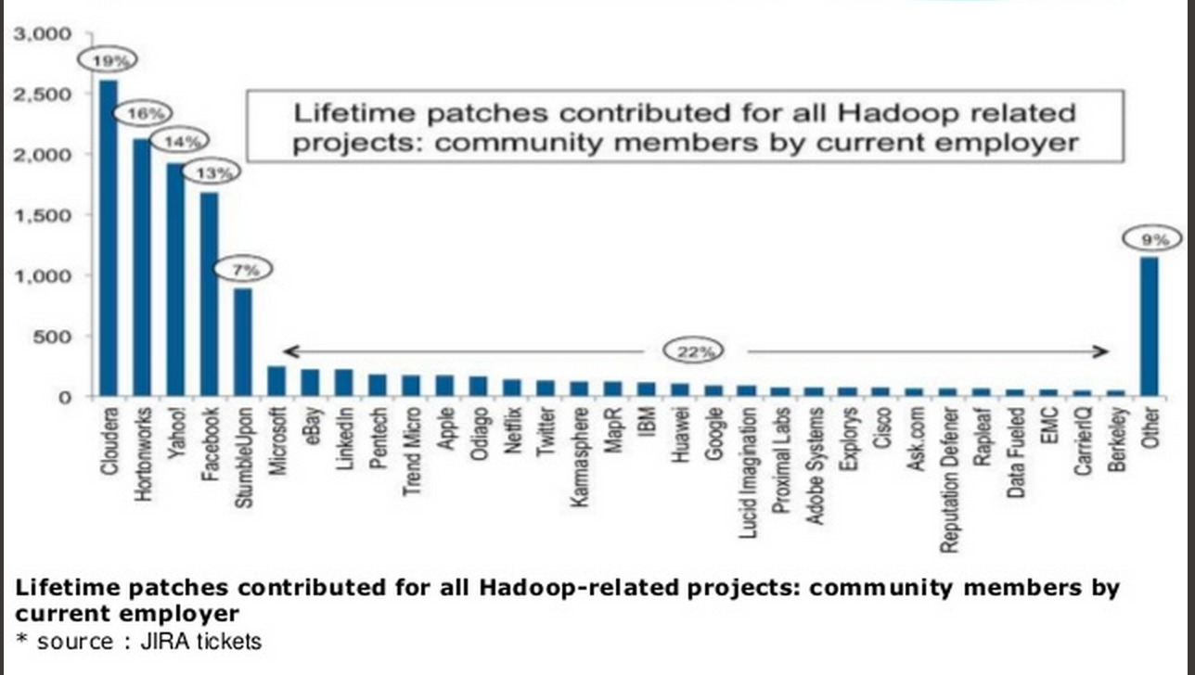
who built Hadoop?

